Slide 1
Lecture 03: Operating System

Slide 2
Objectives
Explain the basic role of an operating system in modern-day computers
Explain the general functions and components of an operating system
Discuss the interfacing between the operating system and application program or the user
Trace the history of the development of operating systems
Explain the different types of operating systems
Get an overview on some operating systems such as unix and msdos

Slide 3
Contents
1. Introduction
2. Introduction to Operating System
3. Functions of an Operating System
4. Components of an Operating System
5. Interaction with Operating System
6. History of Operating Systems
7. Types of Operating Systems
8. An Overview of UNIX Operating System
9. An Overview of MSDOS
10. Summary
11. Exercises

Slide 4
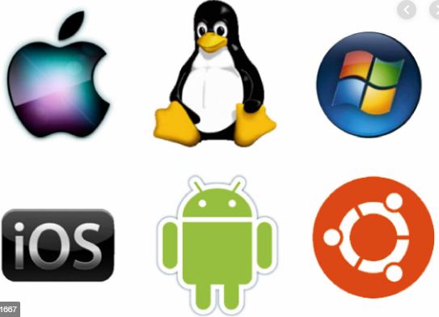
1. Introduction
Computer software can be divided roughly into two parts: system programs, which manage the operation of the computer itself, and application programs, which perform the actual work the user wants. The most important system program is the operating system (OS) that controls all the computer resources and provides the base upon which the application program can be written

Slide 5
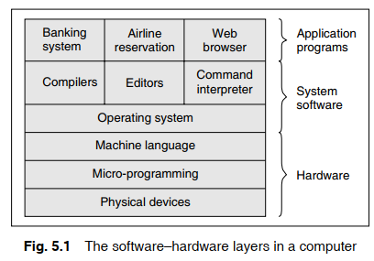
1. Introduction
One of the major functions of the operating system is to hide all this complexity and give the programmer a more convenient set of instructions to work with.

Slide 6
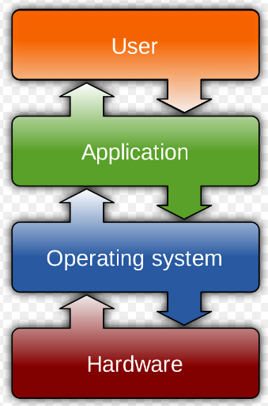
2. Introduction to Operating System
An operating system is an important part of almost every computer system that comprises three main components:
The hardware (memory, Cpu, arithmetic-logic unit, various storage devices, I/O, peripheral devices, etc.)
Systems programs (operating system, compilers, editors, loaders, utilities, etc.)
Application programs (database systems, business programs, etc.)

Slide 7
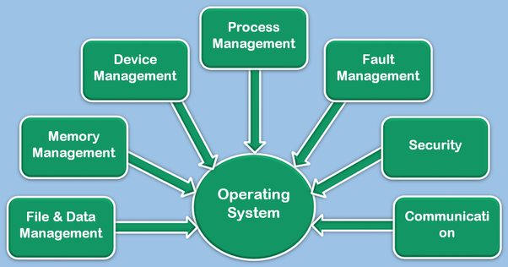
2. Introduction to Operating System
An operating system is also a control program. It controls the execution of user programs to prevent errors and improper use of the computer. Therefore, it may be defned as follows: An operating system (OS) refers to the software on a computer that lets it run applications, control peripherals, and communicate with other computers

Slide 8
5.3 Functions of an operating system
Process management
The operating system is responsible for the following activities with respect to process management: The creation and deletion of user and system processes The suspension and resumption of processes Keep track of the resources (processors and the status of processes). Allocate the resources to a process by setting up the necessary hardware reclaim the resources when the process relinquishes processor usage, terminates, or exceeds the allowed amount of usage The provision of mechanisms for process synchronization—decide which process gets the processor, when, and for how much time The provision of mechanisms for deadlock handling

Slide 9
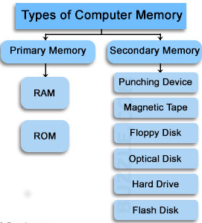
5.3 Functions of an operating system
Memory management
Primary memory management
The operating system is responsible for the following activities for fulflling memory management functions. + Keep track of the different parts of memory currently being used by various processes + Decide which processes are to be loaded into memory when memory space becomes available + Allocate and de-allocate memory space as needed

Slide 10
5.3 Functions of an operating system
Secondary memory management
The operating system is responsible for the following activities for accomplishing the disk management functions: +Free space management +Storage allocation +Disk scheduling
Device (I/O) management
One of the purposes of an operating system is to hide the peculiarities of specifc hardware devices from the user
+ A buffer memory system + A general device driver program + Drivers for specifc hardware devices

Slide 11
5.3 Functions of an operating system
File management
The operating system is responsible for the following activities for accomplishing the fle management functions: + Creation and deletion of fles + Creation and deletion of directory + Support of primitives for manipulating fles and directories + Mapping of fles onto disk storage + Backup of fles on stable (non-volatile) storage

Slide 12
5.3 Functions of an operating system
Protection
Protection refers to a mechanism for controlling the access of programs, processes, or users to the resources defned by a computer and the controls to be imposed, together with some means of enforcement.
For example, the various processes in an operating system must be protected from each other’s activities

Slide 13
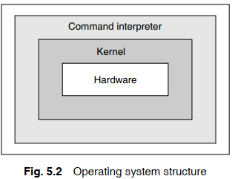
5.4 Components of an operating system
Command interpreter
Many commands are given to the operating system by control statements. A program that reads and interprets control statements is automatically executed. This program is variously called (a) the control card interpreter, (b) the command line interpreter, (c) the shell (in UNIX), and so on. Its function is quite simple: it gets the command statement and executes it

Slide 14
5.4 Components of an operating system
Kernel: Kernel is a core part of the operating system and is loaded on the main memory when it starts up. It is the core library of functions; the operating system ‘knows’. In the kernel, there are the functions and streams to communicate with the system’s hardware resources
The main functions of the kernel are as follows: + To provide a mechanism for the creation and deletion of processes + To provide Cpu scheduling, memory management, and device management for these processes + To provide synchronization tools so that the processes can synchronize their actions + To provide communication tools so that processes can communicate with each other

Slide 15
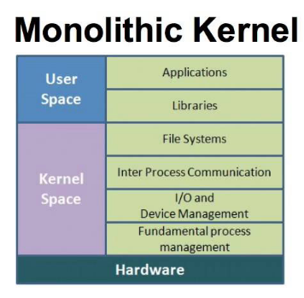
5.4 Components of an operating system
There are two different methodologies for designing a kernel: monolithic kernels and microkernels
The monolithic kernel is the design that is used in operating systems such as Windows and Linux. In this case, the kernel is a set of tightly integrated packages that understand and handle the complete hardware of the machine
A microkernel, on theother hand, takes a different approach. Microkernels usually provide only minimal services such as defning memory address spaces, interprocess communication methods and process, and thread management. All other features, such as hardware management or I/O locking and sharing, are implemented as processes running independently of the microkernel

Slide 16
5. Interaction with Operating System
System calls
System calls provide the interface between a running program and the operating system. These calls are generally available as assembly language instructions, and are usually listed in the manuals used by assembly language programmers

Slide 17
5. Interaction with Operating System
Operating system commands Apart from system calls, users may interact with the operating system directly by means of commands. For example, if the user wants to list fles or sub-directories in MsDOs, the DIR command is invoked

Slide 18
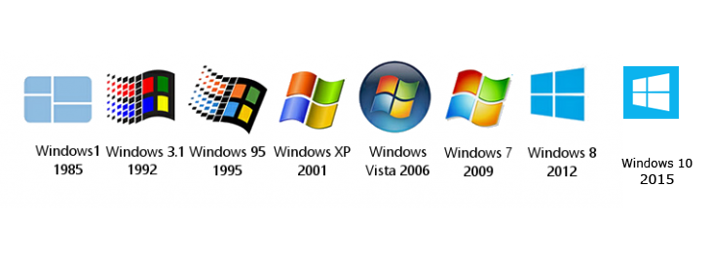
6. History of operating systems
As the history of computer operating systems run parallel to that of computer hardware, it can be generally divided into five distinct time periods, called generations, that are characterized by hardware component technology, software development, and mode of delivery of computer services

Slide 19
6.1 First generation (1945–55)
The first generation marked the beginning of commercial computing, including the introduction of eckert’s and Mauchly’s univac I in early 1951, and a little later, the IBM 701, also known as the Defense Calculator. The first generation computer was characterized by the vacuum tube as the active component technology
This mode of computer operation was called ‘closed shop’ and was marked by the appearance of hired operators who would select the job to be run, then load the program in the system, run the program, select another job, and so on

Slide 20
6.2. Second generation (1956–63) transistors and Batch system
Transistors replaced vacuum tubes as the hardware component technology in the second generation of computer hardware. In addition, some very important changes in hardware and software architectures occurred during this period. For the most part, computer systems remained card- and tape-oriented systems. Signifcant use of random access devices, that is, disks, did not appear until the end of the second generation. program processing was, mostly, provided by large, centralized computers operated under monoprogrammed batch processing operating systems

Slide 21
6.2. Second generation (1956–63) transistors and Batch system
The second generation was a period of intense operating system development. It was also the period for sequential batch processing. But the sequential processing of one job at a time remained a signifcant limitation. Thus, there continued to be low CPU utilization for I/O-bound jobs and low I/O device utilization for CPU-bound jobs. This was a major concern, since computers were still very large (room-size) and expensive machines. researchers began to experiment with multiprogramming and multiprocessing in their computing services called the time-sharing system. A noteworthy example is the Compatible Time Sharing System (CTSS) developed at MIT during the early 1960s

Slide 22
6.3 Third generation (1964–80)
The third generation offcially began in April 1964 with IBM’s announcement of its System/360 family of computers. Hardware technology began to use integrated circuits (ICs), which yielded signifcant advantages in both speed and economy

Slide 23
6.4 Fourth generation
With the development of LSI (Large Scale Integration) circuits, chips containing thousands of transistors in a square centimeter of silicon, the age of personal computers dawned

Slide 24
7. Types of Operating Systems
7.1 Batch process operating system
In a batch process operating system, environment users submit jobs to a central place where these jobs are collected in batch, and subsequently placed in an input queue in the computer where they are run. In this case, the user has no interaction with the job during its processing, and the computer’s response time is the turnaround time, that is, the time from submission of the job until execution is complete and the results are ready for return to the person who submitted the job

Slide 25
7.1 Batch process operating system
Non-interactive environment
There are some difficulties with a batch system from the point of view of a programmer or user. Batch operating systems allow little or no interaction between users and executing programs. The turnaround time is very high. users have no control over the intermediate results of a program. This type of arrangement does not provide any ﬂexibility in software development

Slide 26
7.2 Multiprogramming operating system
A multiprogramming operating system allows more than one active user program (or part of user program) to be stored in the main memory simultaneously Multitasking operating systems A program in execution is called a process or task. A multiprogramming operating system is one, which in addition to supporting multiple concurrent processes, several processes in execution states simultaneously, allows the instruction and data from two or more separate processes to reside in primary memory simultaneously

Slide 27
7.2 Multiprogramming operating system
Multi-user operating system
It allows simultaneous access to a computer system through one or more terminals. Although frequently associated with multiprogramming, a multi-user operating system does not imply multiprogramming or multitasking. A dedicated transaction processing system such as railway reservation system that has hundreds of terminals under the control of a single program is an example of a multi-user operating system

Slide 28
7.2 Multiprogramming operating system
Multiprocessing system
It is a computer hardware confguration that includes more than one independent processing unit. The term multiprocessing is generally used to refer to large computer hardware complexes found in major scientifc or commercial applications. The words multiprogramming, multiprocessing, and multitasking are often confusing. There are, of course, some distinctions between these similar but different terms

Slide 29
7.3 Time-sharing operating systems
A time-sharing operating system operates in an interactive mode with a quick response time. The user types a request to the computer through a keyboard. The computer processes it and a response, if any, is displayed on the user’s terminal. A time-sharing system allows many users to simultaneously share the computer resources

Slide 30
7.4 Real-time operating systems
The fourth class of operating systems, real-time operating systems, are designed to service those applications where response time is of essence in order to prevent error, misrepresentation, or even disaster. examples of real-time operating systems are those that handle airlines reservations, machine tool control, and monitoring of a nuclear power station. In these cases, the systems are designed to be interrupted by external signals that require the immediate attention of the computer system

Slide 31
7.4 Real-time operating systems
Memory management In real-time operating systems there is a swapping of programs between primary and secondary memory. Most of the time, processes remain in primary memory in order to provide quick response. Therefore, memory management in a real-time system is less demanding compared to other types of multiprogramming systems
I/O management Time-critical device management is one of the main characteristics of a real-time system. It also provides a sophisticated form of interrupt management and I/O buffering
File management The primary objective of fle management in real-time systems is usually the speed of access rather than effcient utilization of secondary storage. In fact, some embedded real-time systems do not have secondary memory

Slide 32
7.5 Network operating system
Some of the typical characteristics of network operating systems are the following. + each computer has its own private operating system instead of running as part of a global system-wide operating system. + users normally work on their systems; using a different system requires some kind of remote login instead of having the operating system dynamically allocate processes to Cpus. + Users are typically aware of where each of their fles are kept and must move a fle from one system to another with explicit fle transfer commands instead of having file placement managed by the operating system

Slide 33
7.6 Distributed operating system
A distributed computing system consists of a number of computers that are connected and managed so that they automatically share the job-processing load among the constituent computers, or separate the job load, as appropriate, to particularly confgured processors. Such a system requires an operating system that in addition to the typical stand-alone functionality, provides coordination of the operations and information ﬂow among the component computers

Slide 34
7.6 Distributed operating system
Advantages of distributed operating systems Though the design and implementation is complex, there are certain advantages for which the distributed system is used. Some of these are given below
Major breakthrough in microprocessor technology
Incremental growth
Reliability

Slide 35
7.6 Distributed operating system
File system The distributed operating system supports a single global fle system visible from all machines. When this method is used, there is one directory for executable programs (in unix, it is the bin directory), one password fle, and so on Protection In a true distributed system, there is a unique uID for every user. That uID should be valid on all machines without any mapping. In this way no protection problems arise on remote access to fles; a remote access can be treated like a local access with the same uID

Slide 36
7.6 Distributed operating system
Program execution In the most distributed case, the system chooses a Cpu by looking at the processing load of the machine, location of fle to be used, etc. In the least distributed case, the system always run the process on one specifc machine (usually the machine on which the user is logged in)

Slide 37
8. An Overview of UNIX Operating System
unix is an operating system. It was created in the late 1960s, in an effort to provide a multi-user, multitasking system for use by programmers. The philosophy behind the design of unix was to provide simple, yet powerful utilities that could be pieced together in a ﬂexible manner to perform a wide variety of tasks

Slide 38
8. An Overview of UNIX Operating System
Reasons for success of unix
+ Portability
+Open system
+Rich and productive programming environment
+Communication
+Multi-user capability +Multitasking

Slide 39
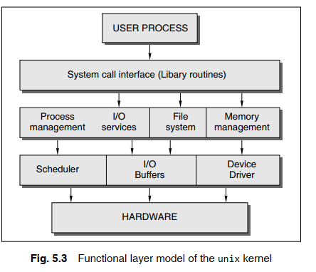
8. An Overview of UNIX Operating System
Components of unix +Kernel +Command interpreter

Slide 40
9. An Overview of MSDOS
The origin of MsDOS can be traced back to 1980 when Seattle Computer producers developed a microcomputer operating system for in-house use. It was called qdos. It was renamed 86-dos in the late 1980 after modifications
Version 4.0, released in 1988, provided the dosshell, expanded memory driver, and larger than 32MB hard disk partitions. Version 5.0, released in 1991, was designed as an upgrade. This version enabled device drivers to be placed in upper memory, leaving more conventional memory available to programs. MSDOS 6.22 was released in 1994. The latest version of dos is MsDOS 7, which is provided as a part of and inside the Windows system

